Slide 1
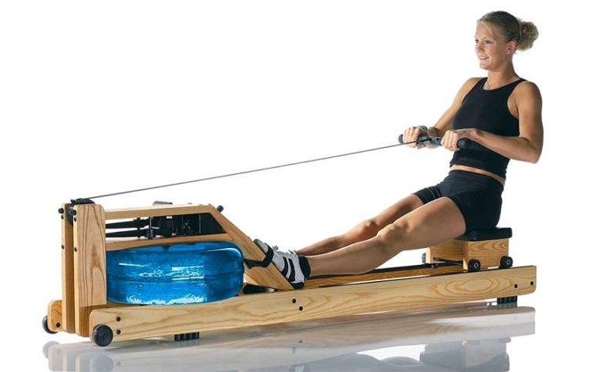
HASSRA
HASSRA NORTH EAST
HASSRA National Festival Fri 12th July 2024 to Sun 14th July 2024 at Warwick University.
If you are interested in taking part in the festival at one of the events below, please send an email showing your preference to HASSRA.NORTHEASTFESTIVALS@DWP.GOV.UK Events may have practice sessions or qualifiers dependant on levels of interest, we will put you in touch with the individual event organiser as numbers are limited. Please put forward your name and chosen event for consideration to represent the North East. Transport by bus, accommodation and meals are included from HASSRA. You must be a member of HASSRA when you apply and when you attend. More details on the events are available o HASSRA Live – National Festival page. Closing date is 01/03/24. Any interest received after 01/03/24 will be disregarded. Your place is not guaranteed until confirmed by the Committee
Multi Gym Triathlon M & F General Knowledge Quiz course Angling
Archery Footgolf
5 aside football- mens Mixed Rounders Wild water swimming (TB(TBC)
Badminton Music / Singing Squash Tennis Walking (TBC)
Give us a Clue game
This is an expression of interest and does not guarantee a place. You must be available to travel on Fri 12th July 2024 so please book your annual leave now. However: Please do not register your attendance on HASSRA live until your place is confirmed by North East festivals committee . Thank you and good luck

