Slide 1
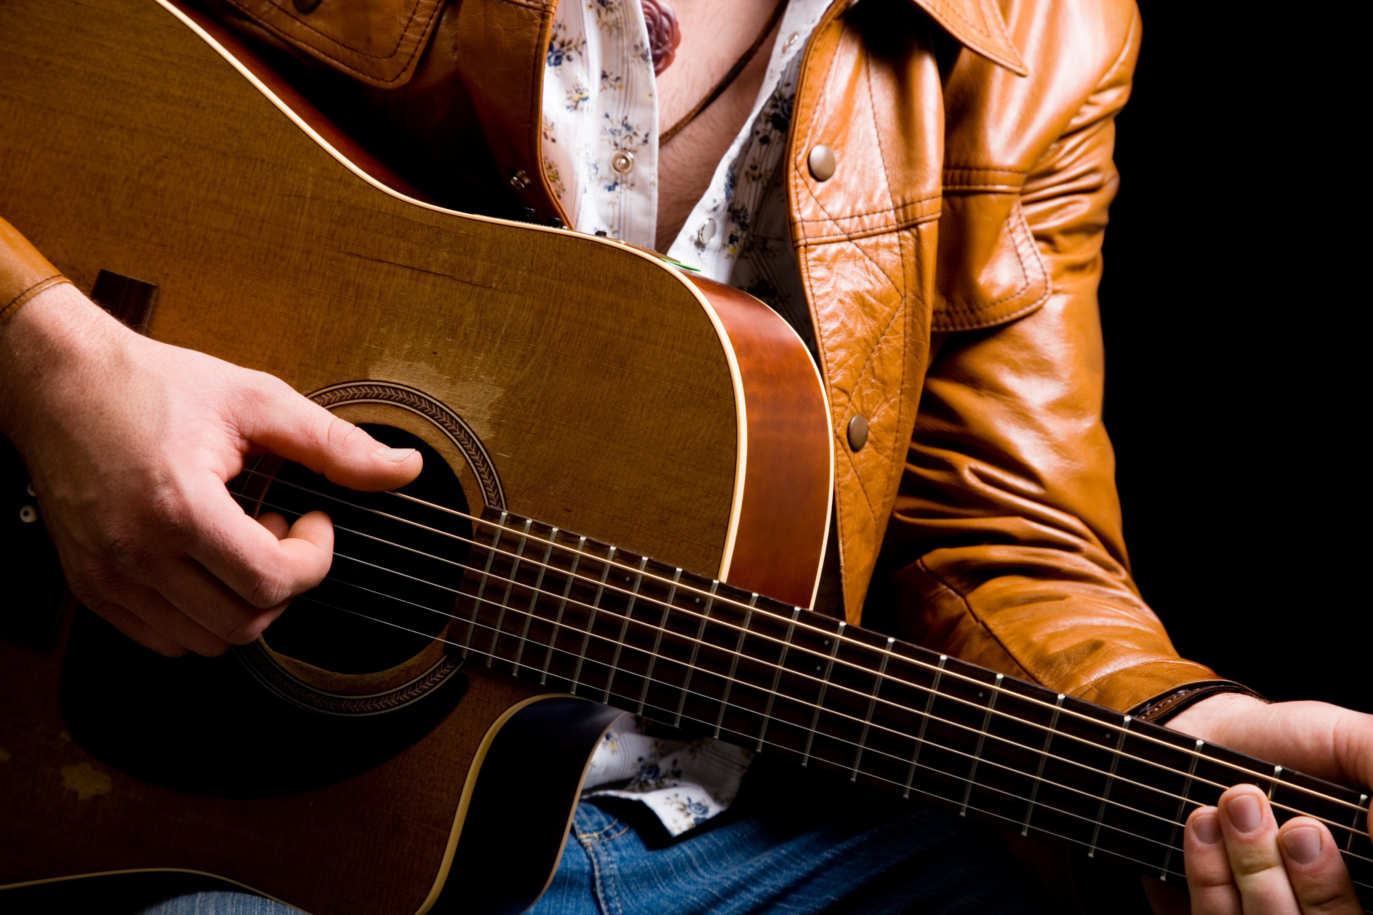

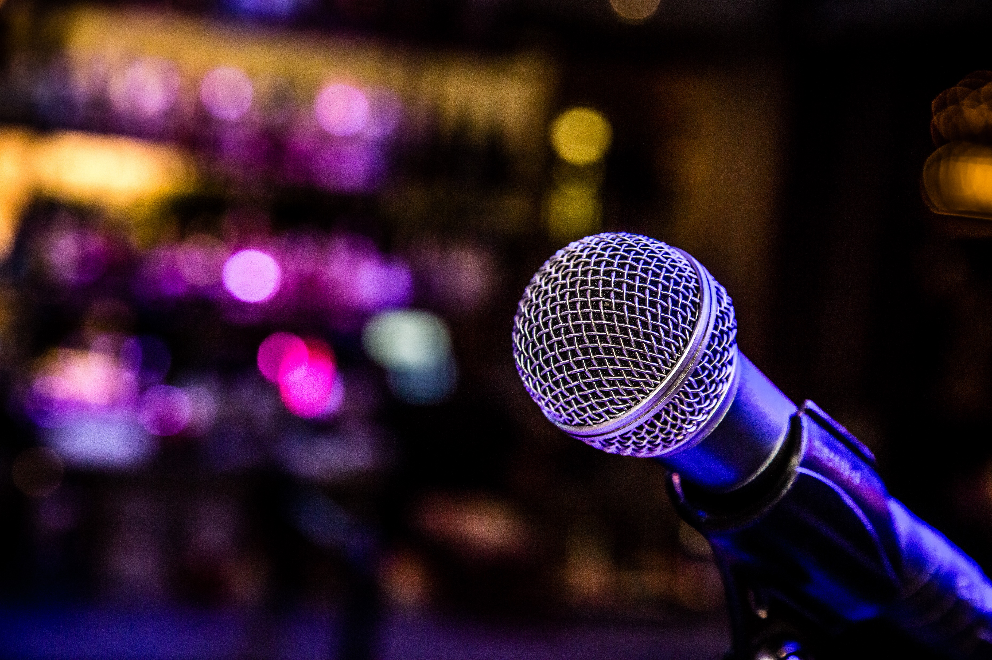
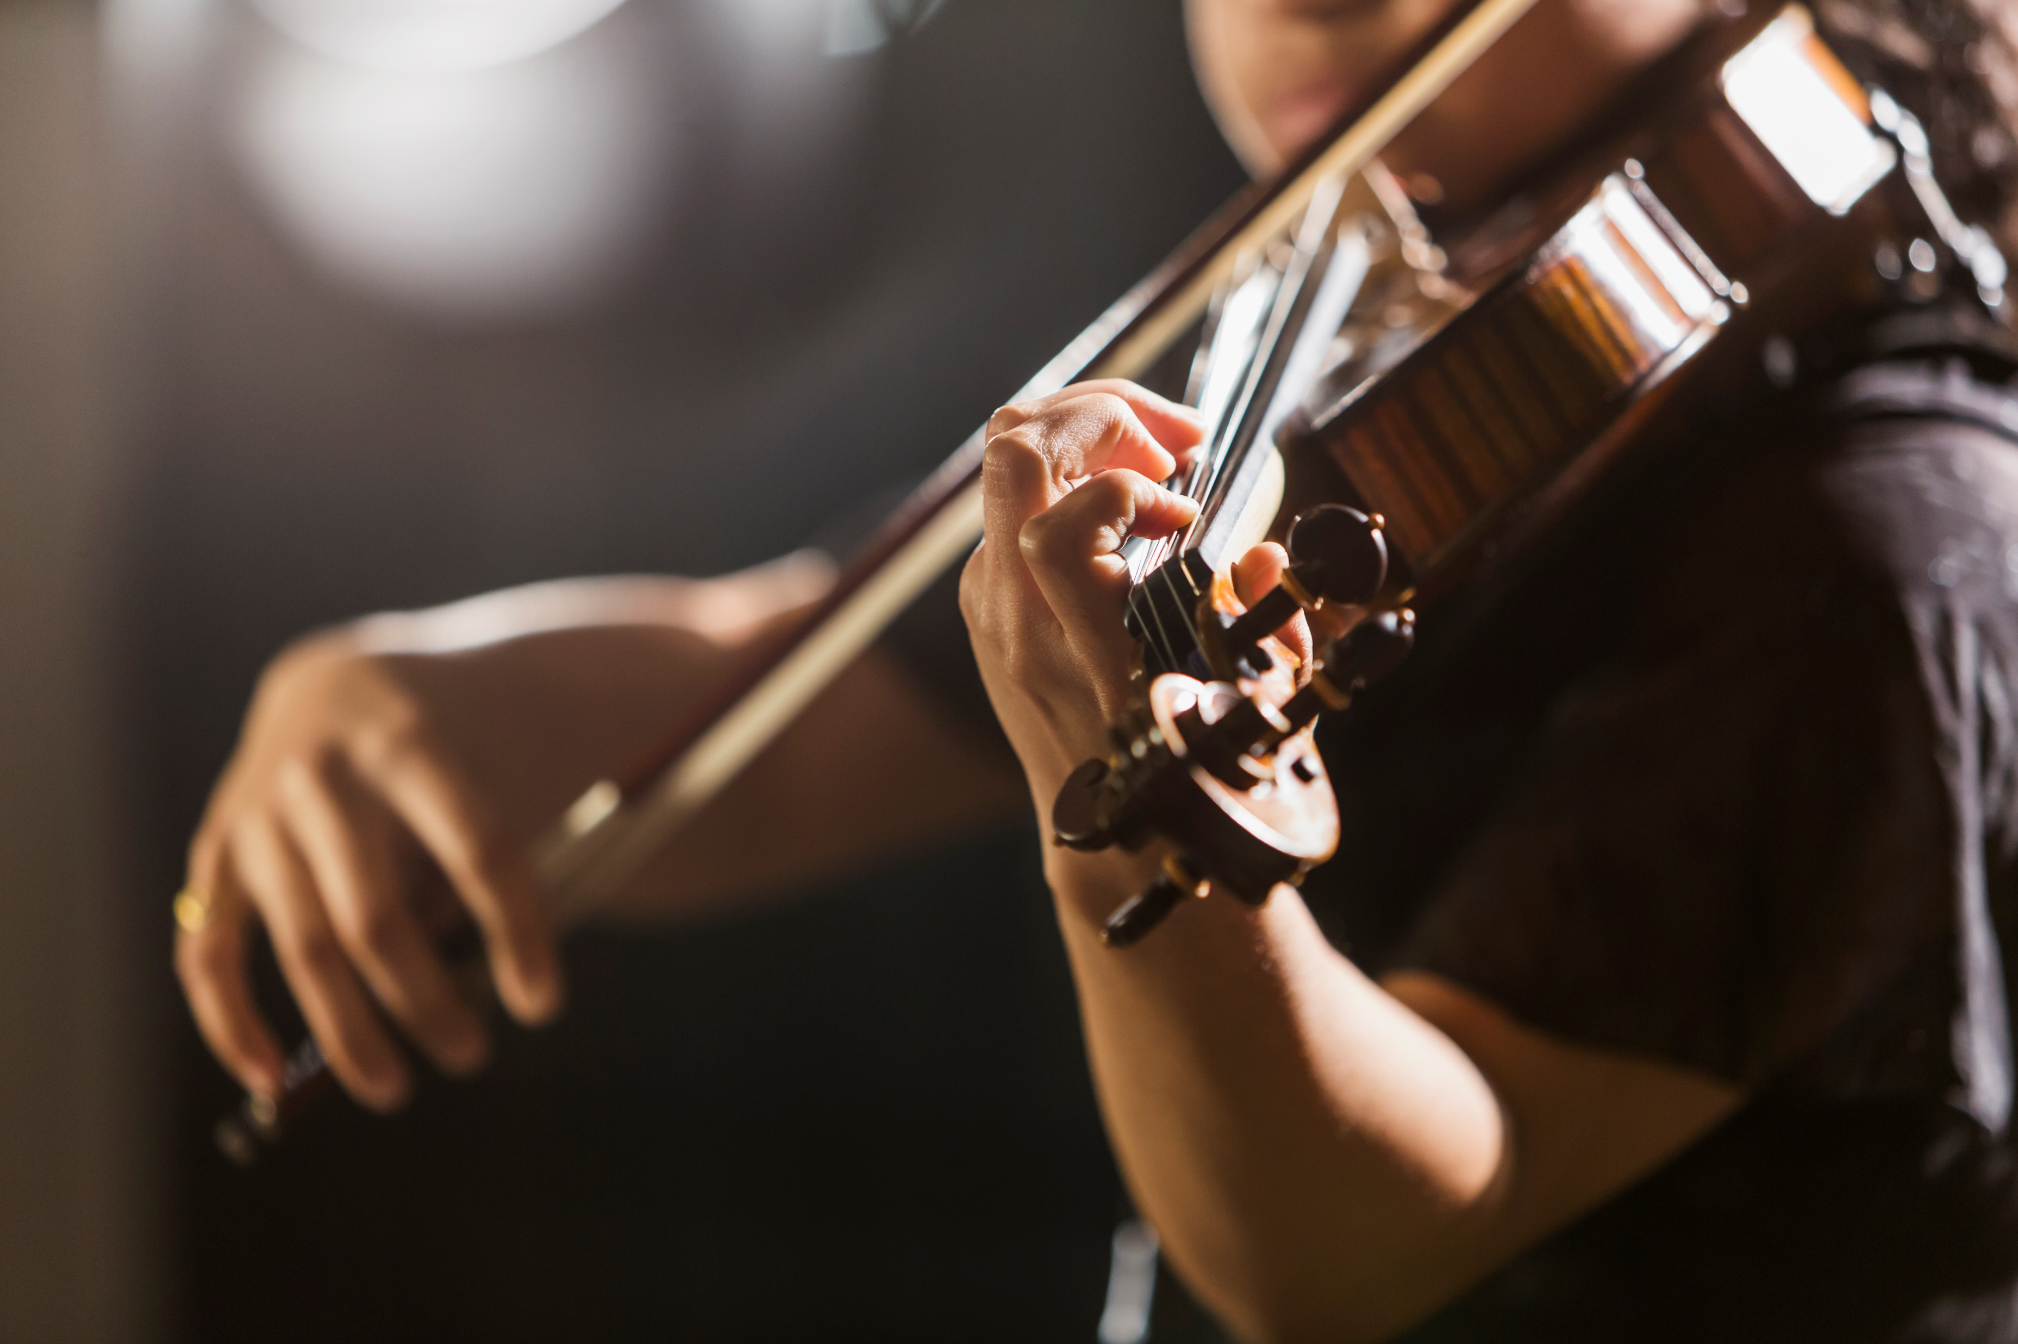



Music Concert Cashback Offer
Enjoy a music concert in 2025 and receive 10% cashback on your tickets courtesy of HASSRA West Midlands
Terms & Conditions:
10% cashback is available on x2 tickets purchased, up to a maximum value of £100 per ticket (maximum cashback value £20.00).
Members are eligible to claim for one music concert / festival (in the UK) throughout the duration of the offer between 01/01/2025 – 31/12/2025.
The music concert must take place in 2025.
Cashback claims are for tickets only. No other items purchased, for example programmes, souvenirs, car parking, travel or refreshments are eligible for cashback.​
Tickets for musical theatre are not eligible for this offer.
Members will be reimbursed via BACS payment to the value of 10% of the original ticket costs.
Cashback claims must be received by midnight on Saturday 27 December 2025. You will not be able to submit a cashback claim beyond this date.
HASSRA West Midlands reserves the right to withdraw this cashback offer at any time and without prior notice.
How to Claim:
Claim cashback through the ‘Claim Cashback’ icon within your HASSRA Live account.
Tickets / booking confirmation detailing the cost will need to be uploaded as part of your claim.

