Slide 1

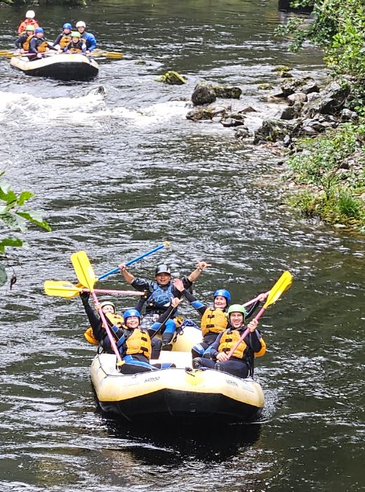


Welcome to HASSRA
Notes:
In this presentation, I will tell you about the amazing offers and activities available to HASSRA members – there is something for everyone – no matter what your interests and hobbies are.

Slide 2
HASSRA – Who we are
Health And Social Security Recreational Association.
Established in 1935 – HASSRA turned 90 in 2025!
HASSRA is a vibrant, inclusive and successful organisation that promotes a healthy work-life balance and wellbeing in the workplace.
HASSRA is DWP’s official Sports and Recreation Association and has over 62,000 members.
Notes:
The Health And Social Security Recreational Association was established in 1935. It has endured, adapted and flourished over the past 90 decades to blossom into the vibrant, current and inclusive organisation it is today – with over 61k members.

Slide 3













HASSRA
Offers
Notes:
Here is a small selection of the wonderful discounts available to members including Insurance, Gym Memberships, Holidays, Spas, Wildlife Adventures, Food and Drink, Theme Parks, Cinema Savings and one of our best offers – English Heritage Membership.

Slide 4







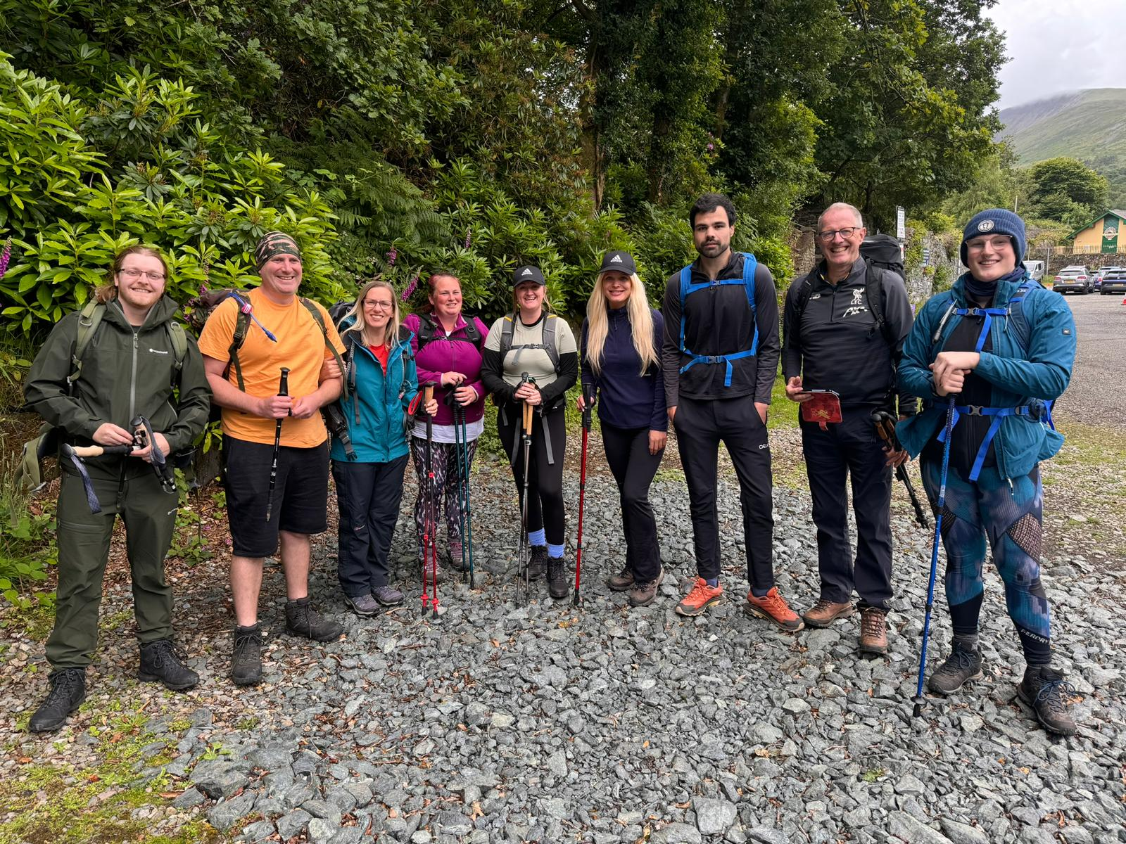
WIN with HASSRA
Notes:
HASSRA offers a variety of ways to win throughout the year. There are competitions such as Photography, Art and newly introduced in 2024 a Wellbeing & Inclusion Competition. There are Fortnightly Puzzles and Monthly Competitions with fabulous prizes to be won. We also provide a variety of face-to-face team activities including Sporting Competitions as well as cultural and fun days out. You can also be part of the HASSRA Lottery with a phenomenal £1m annual prize pot, £78k paid out monthly with 150 prizes and monthly Jackpot of £20k - guaranteed!

Slide 5





HASSRA Initiatives
HASSRA Development Fund
Business Unit Grant
Retired Members’ Grant
Cash for Clubs
Buddy Draw
Notes:
We have a range of funding streams available to support teams and individuals. This includes HDF to help you overcome financial barriers to progress personally in your chosen field (e.g. sport coaching qualifications, sporting activities, musical endeavours etc) Geographically dispersed teams can apply for BUG funding for team building activities. To Celebrate the 90th Anniversary HASSRA introduced the 90th Anniversary Club Grant – funding will be determined by membership number. Cash for Clubs to incentivise clubs to use the On-line portal and simplify the process for running raffles, competitions and events. And the Buddy Draw which puts members and the person or persons they recruit into a draw with a chance of winning cash prizes

Slide 6
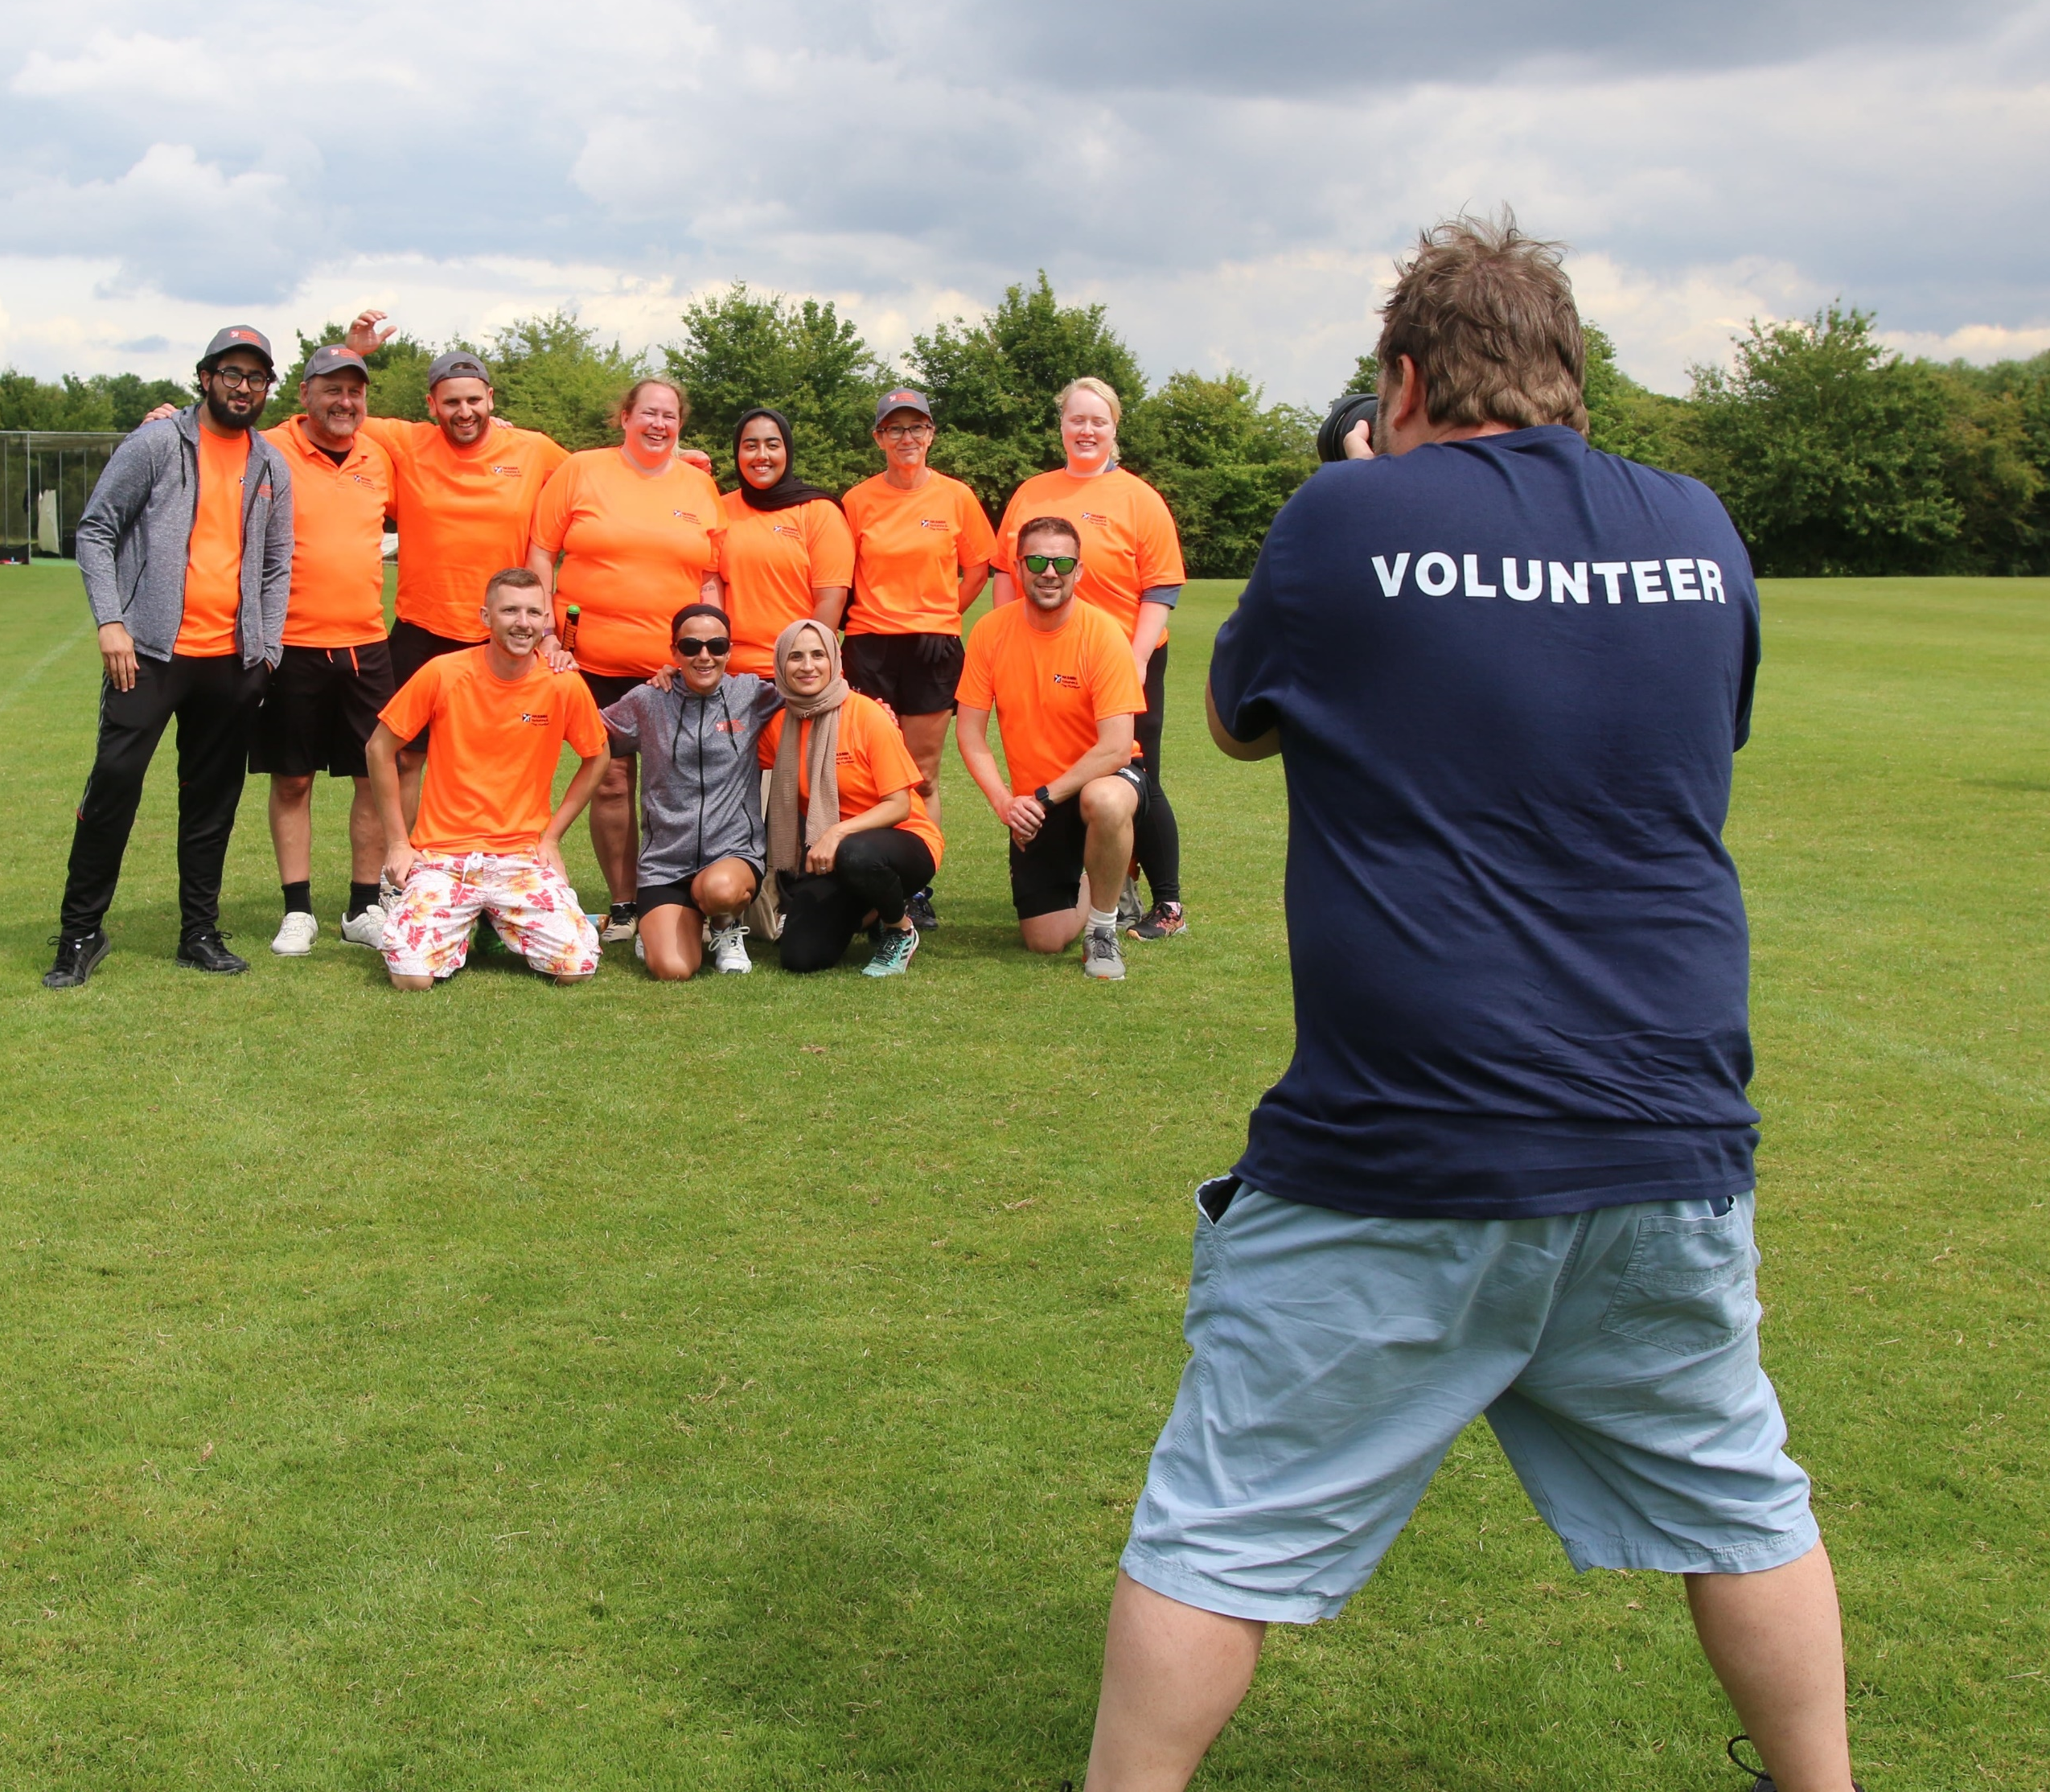


Develop through Volunteering
Planning & Organising
Leadership
Communications
Stakeholder Engagement
Risk Assessment
Budget Management
Notes:
To continue delivering the varied programme of events to entice members to remain – HASSRA needs volunteers and organisers. If this could be you – you will naturally develop skills in areas essential to progress your DWP career. Be passionate about Volunteering – the personal benefits are immense.

Slide 7


HASSRA
Live
HASSRA Live is our online service.
You will have access 24/7 and full control of your personal information.
Information and support for all our Volunteers & Members.
HASSRA
Live
Have access to all the latest news, offers and competitions nationally, regionally and locally.
Access to the online chat service available from
Monday- Friday 9am-5pm.
Notes:
Our IT system is HASSRA Live. It’s accessible from the Working in DWP section of the intranet. It’s recommended that you use a personal e-mail to set up your account when you become a member – to make sure you always get the most up to date information - even when absent from work, and to make sure any e-tickets can be delivered on the go.

Slide 8








Follow us here
Whether you’re into sports, looking after yourself, getting out and about or just having fun, HASSRA offers something for everyone. Find all the latest news here.
Notes:
You’ll find us here – on Social Media, we also have a quarterly magazine – HASSRA Livelife with members stories as well as what’s happening in HASSRA World. Please follow us!

Slide 9


New Member Offers – While Stocks Last!
New Members receive a FREE Cinema Ticket with first order

Slide 10

Become a member today for only…
Quick Re-cap
What we do
£2.45 a month
Join Here

