Slide 2
HASSRA is a vibrant and inclusive association with nearly 60,000
diverse members from all over the country.
With a National team, 12 regions and over 300 local clubs there is something for everyone to enjoy and get involved with.
HASSRA offers a diverse range of sporting, recreational and cultural activities, as well as a valuable package of discounts and membership benefits.
Monthly Lottery draw with £63,000 in cash prizes.
Weekend Festivals featuring a variety of sports and activities.

Slide 8
HASSRA Holiday Offers

Slide 10
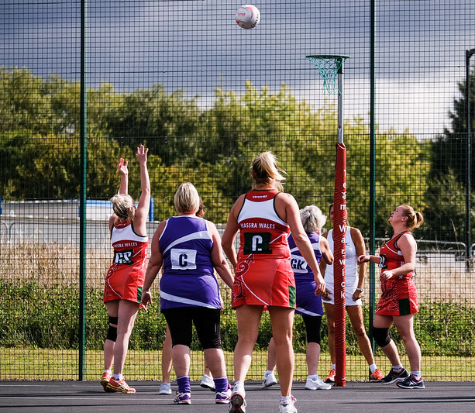
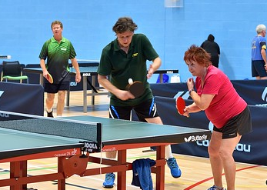
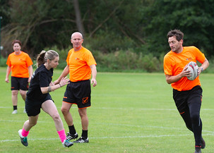
Festivals and Events
HASSRA hosts two weekend festivals each year at the University of Warwick, featuring a diverse range of events.
HASSRA offers a wide range of sporting events and activities that you can take part in nationally, regionally or locally.

Slide 14
It’s easy to join, just head to our website – www.hassra.org.uk and complete an online application form.
You can access all our offers, discounts and keep your personal information up to date via our website.
We will keep you informed of all the latest news via newsletters and social media.
How much does it cost?
Just £2.45 per month!
Any Questions?

