Slide 2
HASSRA is a vibrant Sports and Social with 60,000 members, including past, present and retired staff members.
With a National team, 12 regions and over 300 local clubs there is plenty for you to enjoy.
HASSRA offers an extensive array of sporting, recreational and cultural activities, as well as a valuable package of discounts and membership benefits.
Monthly lottery draw with £55,000 in cash prizes.
Weekend festivals featuring a variety of sports and activities.

Slide 3
Check out what’s happening in your local club and region.

Slide 13
Unlimited access to over 400 historic places for a whole year.
An award winning Members' Magazine delivered four times a year.
A compli­men­tary full colour handbook.
Exclusive offers throughout the year.
Free or reduced price entry to hundreds of historic events.
50% entry to Cadw and Historic Scotland sites (free upon renewal of membership).

Slide 15
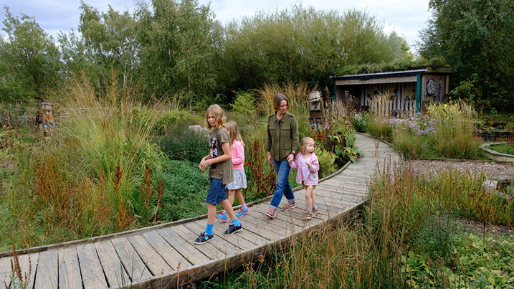
A whole new world of discovery awaits you at WWT Wetland Centres. There’s trails ablaze with wildlife, canoe safaris through quiet waterways, encounters with some of the world’s most endangered birds and adventure playgrounds for little explorers.

Slide 17
Visit four world-class attractions at the heart of maritime Greenwich in a UNESCO World Heritage Site for a fraction of the usual price.
National Maritime Museum
The Royal Observatory
Cutty Sark
Queen’s House

Slide 19
Tastecard+ offers HASSRA members exclusive discounts at over 6,500 restaurants nationwide with all venues providing 2 for 1 meals or 50% off food, plus lots of additional retail discounts.

Slide 21
Join the HASSRA Lottery for a chance to win one of 65 monthly prizes worth £55k !
£12,500 top prize
£2,500 x 4
£500 x 25
£250 x 20
Tickets cost just £1.00!

Slide 22
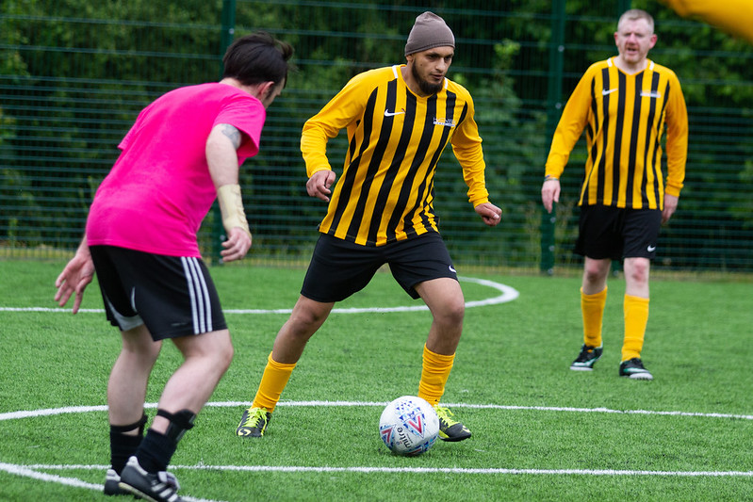
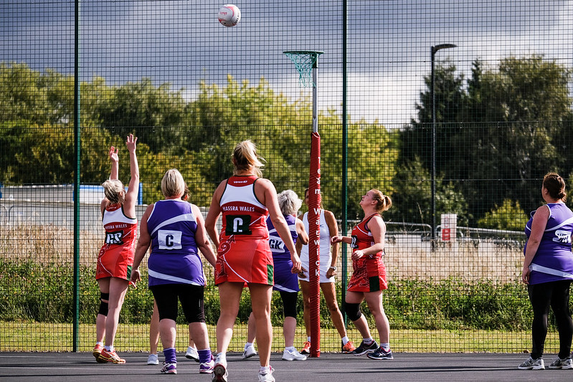
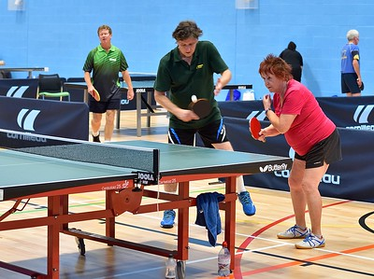
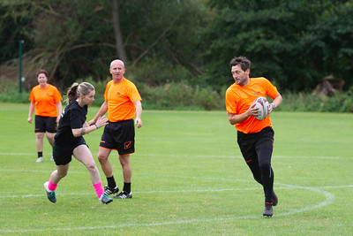
Festivals and Events

Slide 23
HASSRA hosts two weekend festivals each year at the University of Warwick, featuring a diverse range of qualifying events from football to art and netball to photography.
Travel, accommodation, food and event entry all included, a total package worth £240!
It also offers a great opportunity for members to volunteer and become part of our Festival Team.
As well as the festivals HASSRA offers a wide range of sporting events and activities that you can take part in nationally, regionally or locally.
There are also National Teams in some sports such as Sailing, Tennis & Golf, who compete against other government departments throughout the year.

Slide 25
HASSRA can provide financial support to help members achieve their full potential.
There are three main categories under which you can apply:
Personal development – to serve HASSRA and your local community
Sport & Leisure – to develop skills in your chosen sport or activity
For members – who consider themselves to be disadvantaged or to have a disability who wish to take up or develop skills in a sport, pastime or recreational activity.

Slide 27
There are lots of chances for you to win throughout the year with our Fun & Free competitions and big prize giveaways.
Hundreds of prizes including cash, bikes, electronics, shopping vouchers, spa breaks…
and much more!

Slide 28
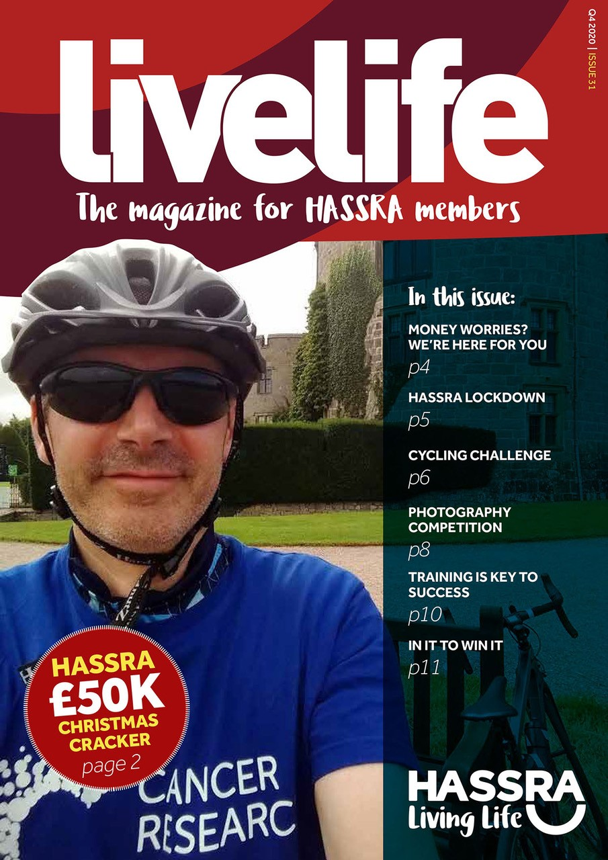
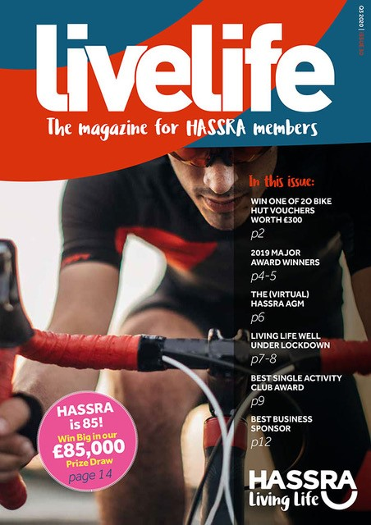
Online Magazine

Slide 30
Join us and both you and the existing member who recommended HASSRA could win one of 200 cash prizes worth £50.
Just remember to fill in their details at the bottom of your online membership application.
All new members who join by 31st March 2021 will be automatically entered into the draw.

Slide 31
It’s easy to join, just head to our website – www.hassra.org.uk and complete an online application form.
You can access all our offers, discounts and keep your personal information up to date via our website.
We will keep you informed on all the latest news via newsletters and social media.
How much does it cost?
Just £2.30 per month!

Slide 32
Any Questions?

