Slide 1



Slide 2







HASSRA is a vibrant and inclusive association with nearly 60,000 members from all over the country.
With 12 regions and over 300 local clubs there is something for everyone to enjoy and get involved with.
HASSRA offers a diverse range of sporting, recreational and cultural activities, as well as a valuable package of discounts and membership benefits.
HASSRA Lottery - £63,000 in cash prizes every month with a £15,000 jackpot - GUARANTEED.
Weekend Festivals featuring a variety of sports and activities.

Slide 3


Slide 4







Slide 5







Slide 6


Slide 7


Slide 8








Slide 9



Slide 10

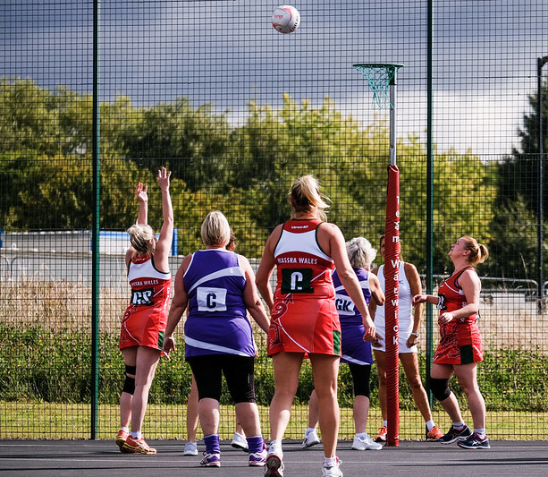
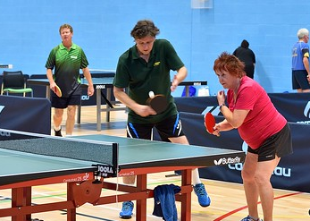
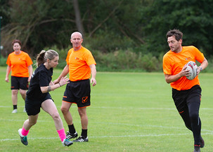
Festivals and Events
HASSRA hosts two weekend festivals each year featuring a diverse range of events.
HASSRA also offers a wide range of local and regional sporting events and activities.

Slide 11


Slide 12


Slide 13


Slide 14

It’s easy to join - just head to www.hassra.org.uk to complete an online application form.
You can access all our offers, discounts and keep your personal information up to date via our website.
We will keep you informed of all the latest news via newsletters and social media.
All this and much more for just £2.45 per month!
Any Questions?

